Slide 1
Capstone Project 2:
Analyzing the stock prices using Deep Learning Algorithms
SWATI ACHARYA
PGAA05

Slide 2
Problem Statement:
The project makes use of LSTM model so as to give fair results for opening prices of stocks. Stock price analysis is one such problem related to time series which could be solved using deep learning algorithms. Time series adds complexity of a sequence dependence among the input variables.
Objectives:
Analyzing the data so as to come to the conclusion which columns to drop
Visualization to draw the insights about the data
Feature Engineering
Using various machine learning algorithms
Data Description:
The columns are date, open, high, low, close and volume. There are two data set: Train & Test. The training data set has around 1250 rows of data.
Models Used:
RNN (Recurrent Neural Network)
LSTM (Long-Short Term Memory)
Working:
Firstly, preprocessing of data would be done which includes scaling of data, checking the shape of data and reshaping it since it’s a time series problem. Secondly, building the RNN model and doing the visualization using the training data set. This would lead to running one more model named LSTM. Again visualization using LSTM model would be carried out. Finally predicting the results using LSTM model and evaluating the rmse for the original test data and predicted test data would be done.
Briefs about Models:
RNN (Recurrent Neural Network):
Feed forward networks cannot be used when predicting a word in a sentence as it will have no absolute relation with the previous set of words. But with Recurrent Neural Network, this challenge can be overcome.

Slide 3
Recurrent means the output at the current time step becomes the input to the next time step. The model considers not just the current input but what it remembers about the preceding elements. RNN are a type of artificial neural network designed to recognize patterns in sequences of data such as text, genomes, handwritings, spoken words, stock markets and government agencies.
RNN makes use of backpropagation. It is an algorithm for supervised learning of artificial neural networks using gradient descent. Given an artificial neural network and an error function the method calculates the gradient of the error function with respect to the neural network’s weights. There are two issues with backpropagation: Vanishing Gradient and Exploding Gradient.
LSTM (Long Short Term Memory)
LSTM are a special kind of recurrent neural networks which are capable of learning long dependencies. LSTM have chain like neural network layer. The first step in the LSTM is to identify that information which is not required and will be thrown away from the cell state. This decision is made by a sigmoid layer called as forget gate layer. The calculation is done by considering the new input and the previous timestamp which eventually leads to the output of a number between 0 and 1 for each number in that cell state. The next step is to decide what new information we are going to store in the cell state. This makes use of sigmoid layer called the input gate layer. The third step is to combine the previously obtained inputs to generate new cell states. Finally we would arrive at the output as per our requirement.
Conclusion:
RNN model was not able to predict the original training set in a well defined manner. It showed the result within the range of 500-600 for any set of input which was incorrect. Therefore, the next approach was to carry it out with LSTM model as its an advanced version. When the predictions were visually analyzed it was observed that the model was quite apt in giving the solution. Furthermore, this LSTM model was used on the new test data set and RMSE was calculated for this so that the deviations from the original test set could be evaluated. A small screenshot of the evaluative result at the end has been provided.

Slide 4
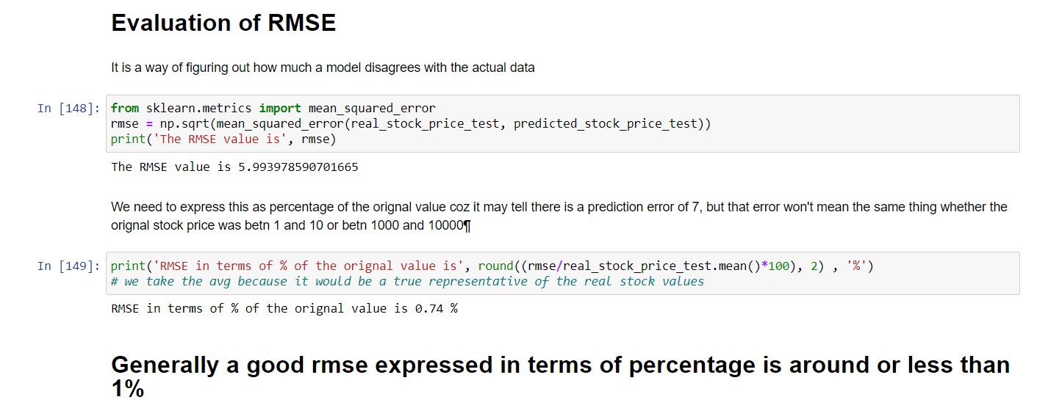
Visualization:
Visualization of the final result is as follow:

